Slide 1
CELLULAR PAYMENT SYSTEM - CPS
A SIMPLE SOLUTION TO COMPLEX PROBLEM
GEEK SQAUD

Slide 2



GEEK SQUAD
MAHENDRA KUMAR VELICHETI
AP21110010193
ADI VISHNU AVULA
AP211100101863
TEAM MEMBERS
CHIRANJEEVI THOTA AP21110010158

Slide 3
CPS - Cellular Payment System
IMPLEMENTING CPS
CPS PROTOTYPE
BENIFITS OF CPS
WELFARE SCHEMES REGULARIZATION
BENIFITS OF REGULATION
A BRIEF OUTLINE

Slide 4
WHAT IS CPS ?
CELLULAR PAYMENT SYSTEM IS A SOFTWARE WHICH ALLOWS US MAKE DIGITAL PAYMENTS WITHOUT INTERNET IN ANY KIND OF MOBILE PHONE.
USING CELLULAR PAYMENT SYSTEM ALLOWS US TO MAKE DIGITAL PAYMENTS USING PHONE CALLS WITH ALL MOBILE PHONES WITH CALLING FACILITY.

Slide 5




REGISTRATION TO CPS
IN ORDER TO USE CPS USER SHOULD REGISTER HIS MOBILE WHICH IS LINKED TO THE BANK ACOUNT
REGISTRATION CAN BE DONE AT THE NEAREST BANK USER NEED TO SET A 6 DIGIT PIN
THE USER NOW ONLY NEEDS TO REMEMBER TWO THINGS:
USER PIN (WHICH MUST BE KEPT A SECRET)
THE PAYMENT TOLLFREE NUMBER

Slide 6
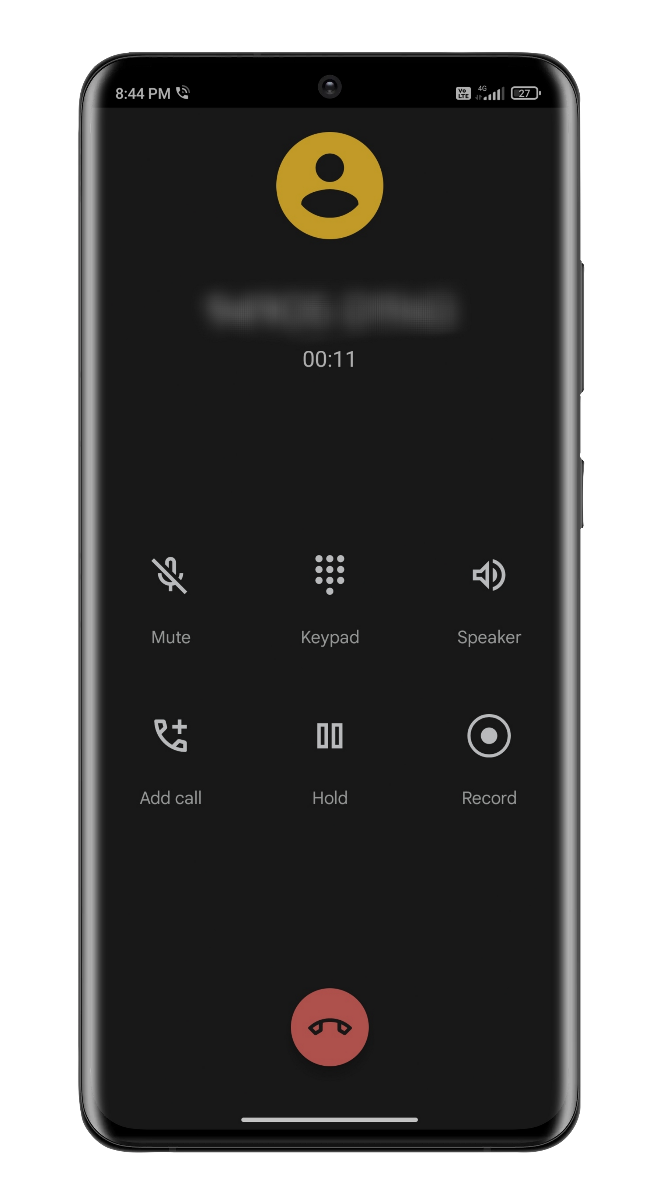
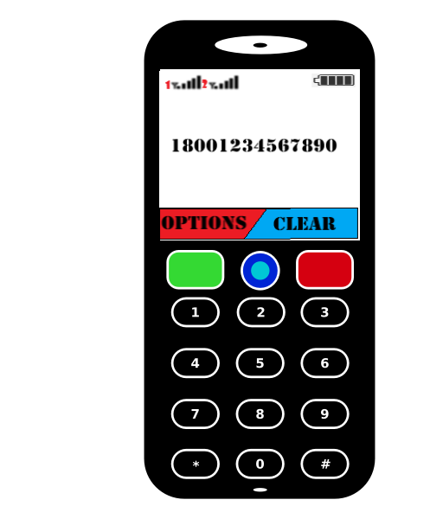
USAGE OF CPS
STEP 1:
THE USER NEEDS TO DIAL THE AVAILABLE TOLL-FREE NUMBERS TO ACCESS THE CPS

Slide 7
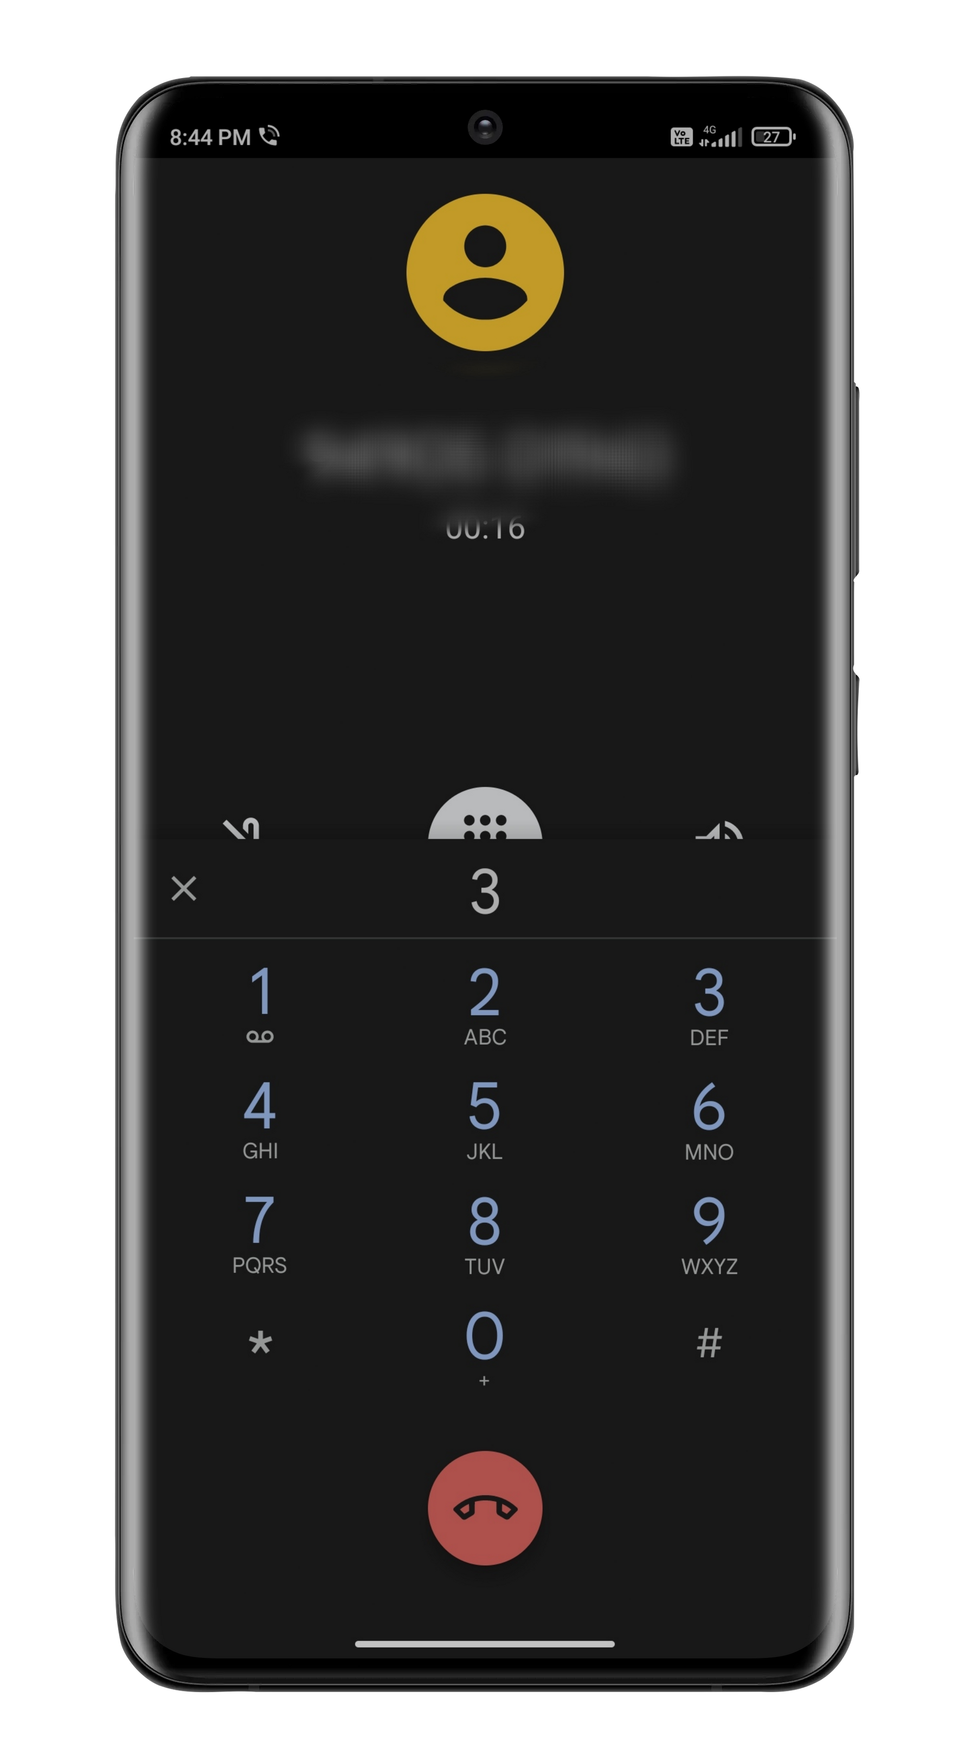
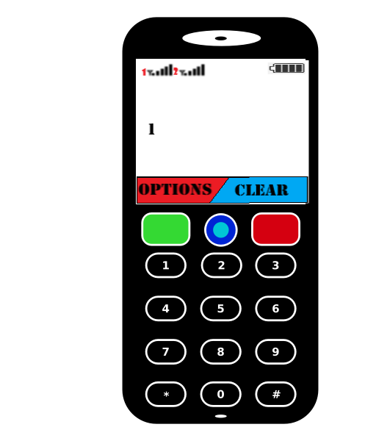
USAGE OF CPS
STEP 2:
THE USER WILL BE GIVEN OPTIONS TO CHOOSE THEIR PREFERRED LANGUAGE FOR THE TRANSACTION. THE CHOICES WILL BE ENGLISH, HINDI AND VARIOUS REGIONAL LANGUAGES

Slide 8
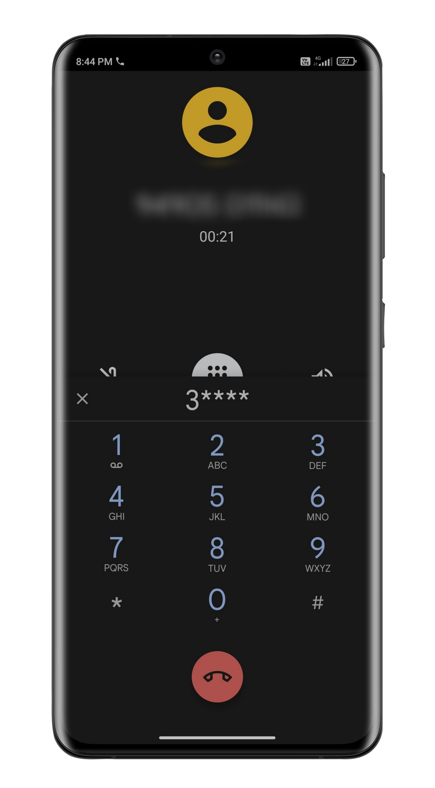
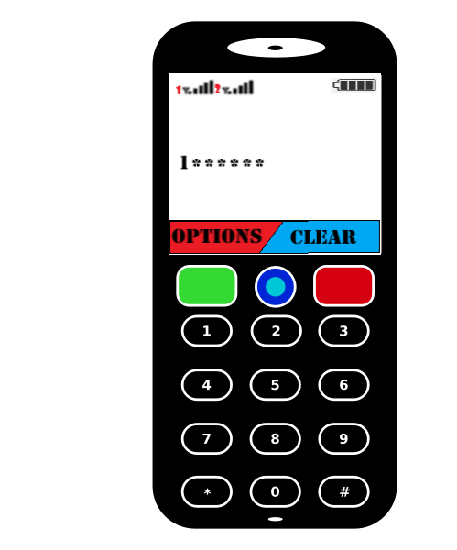
USAGE OF CPS
STEP 3:
THE USER IS NOW PROMPTED TO ENTER THEIR SECURE PIN NUMBER THROUGH THE NUMBERPAD.

Slide 9
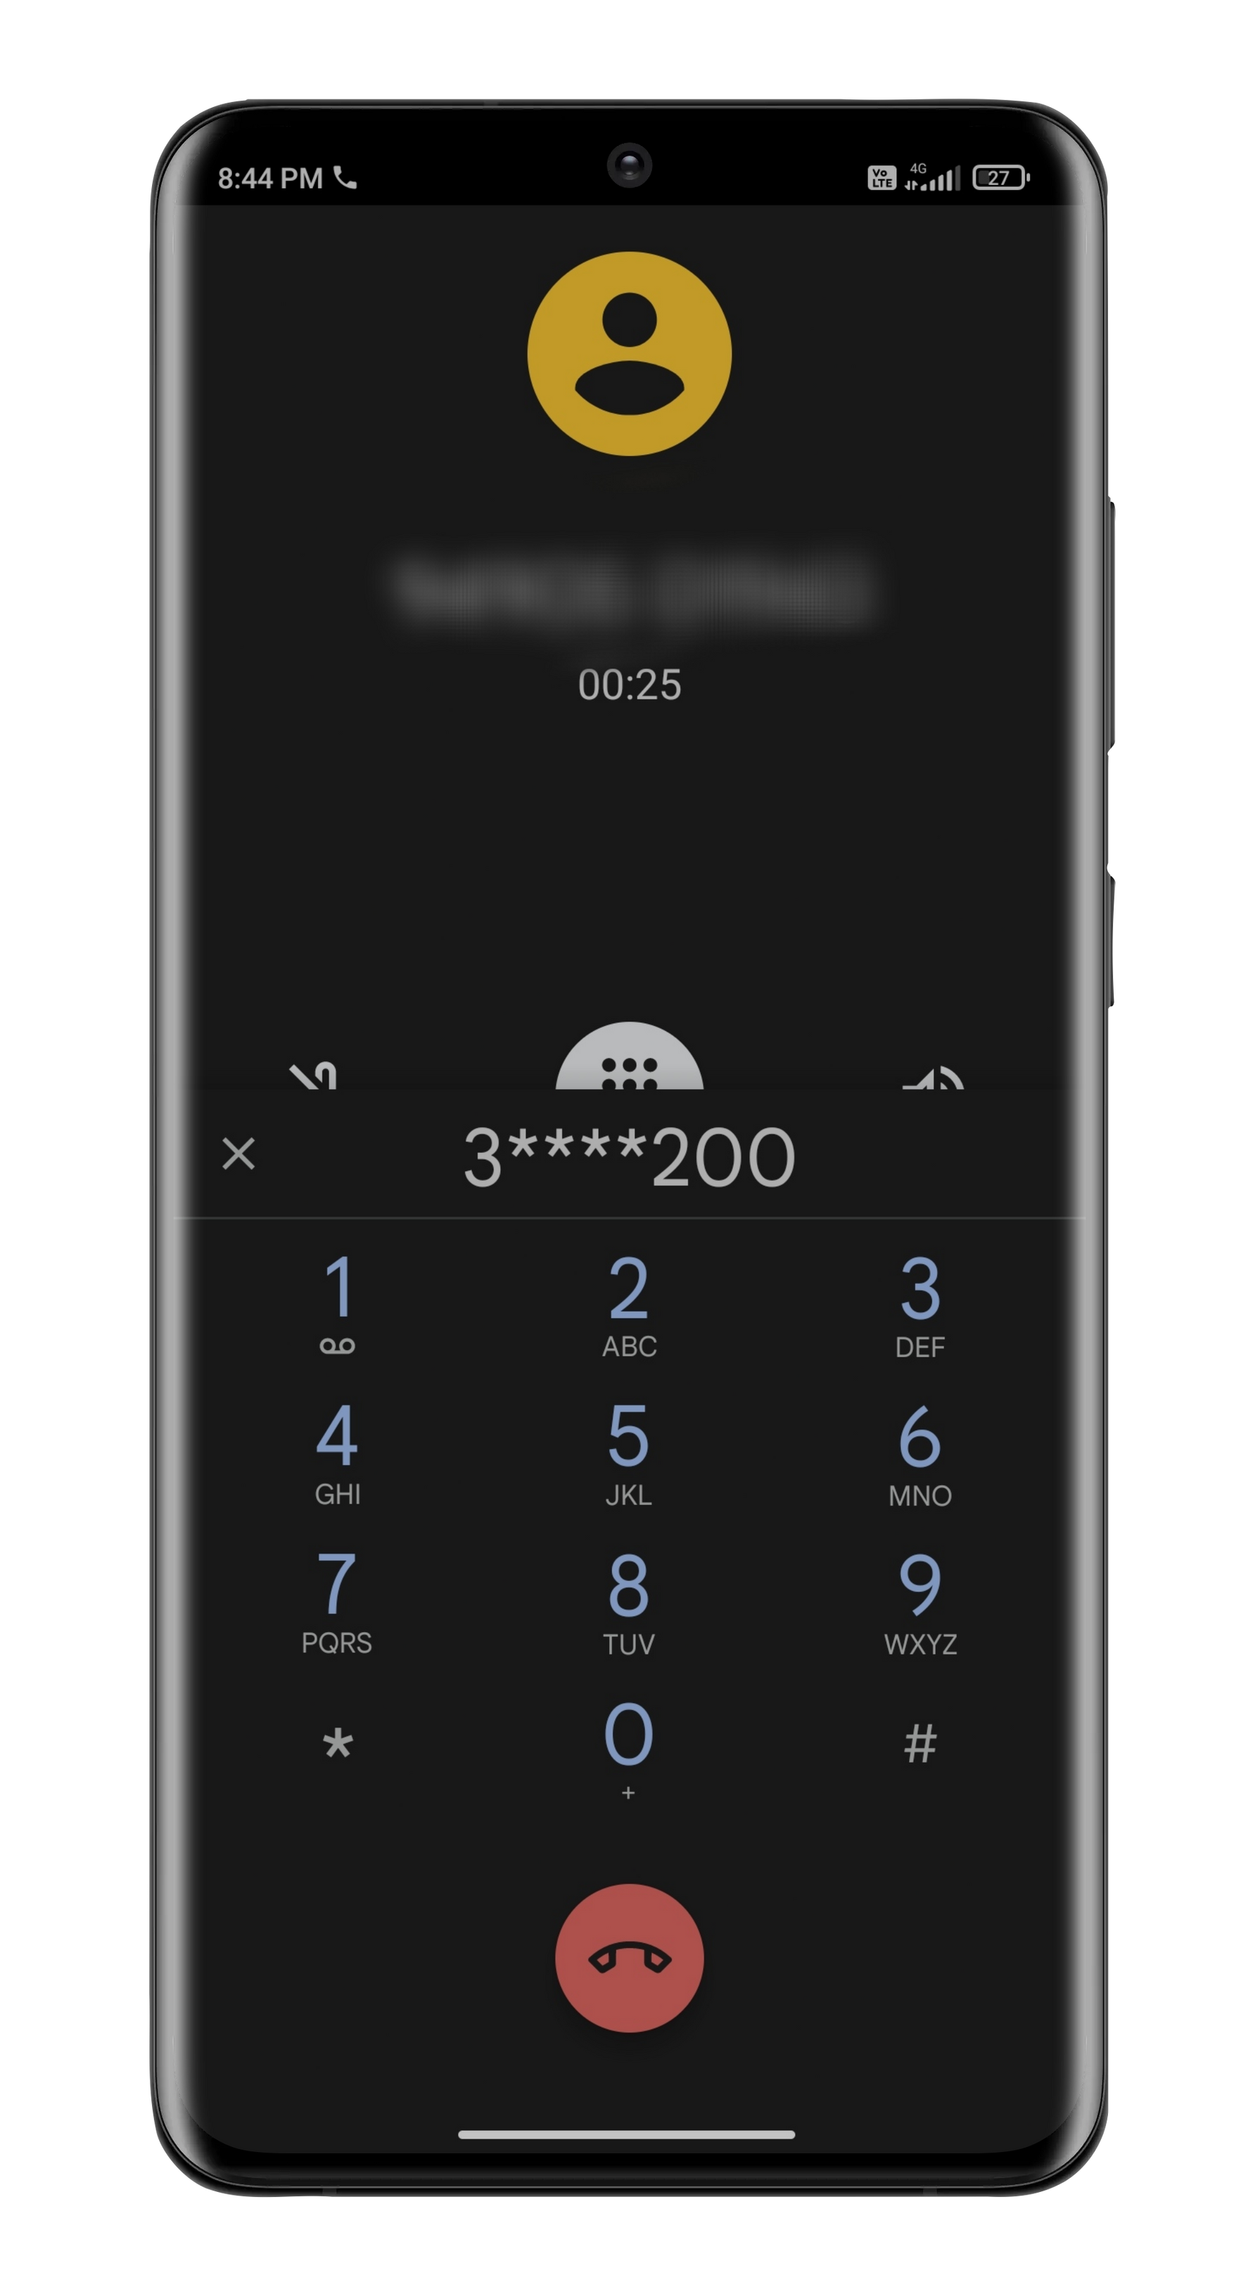
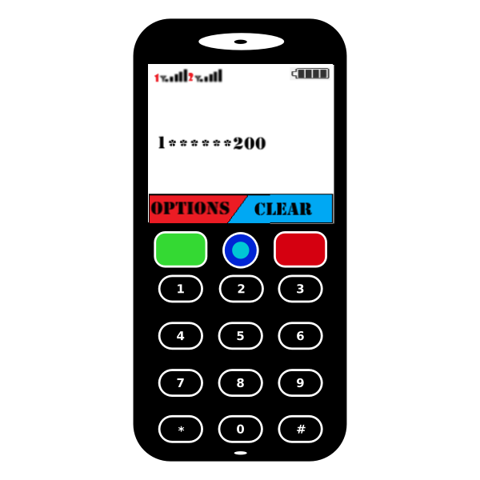
USAGE OF CPS
STEP 4:
IF THE PIN IS CORRECT, THEN THE REMAINING BALANCE IN THE USER'S ACCOUNT WILL BE ANNOUNCED AND THE USER IS ASKED TO ENTER THE AMOUNT HE WANTS TO TRANSFER

Slide 10
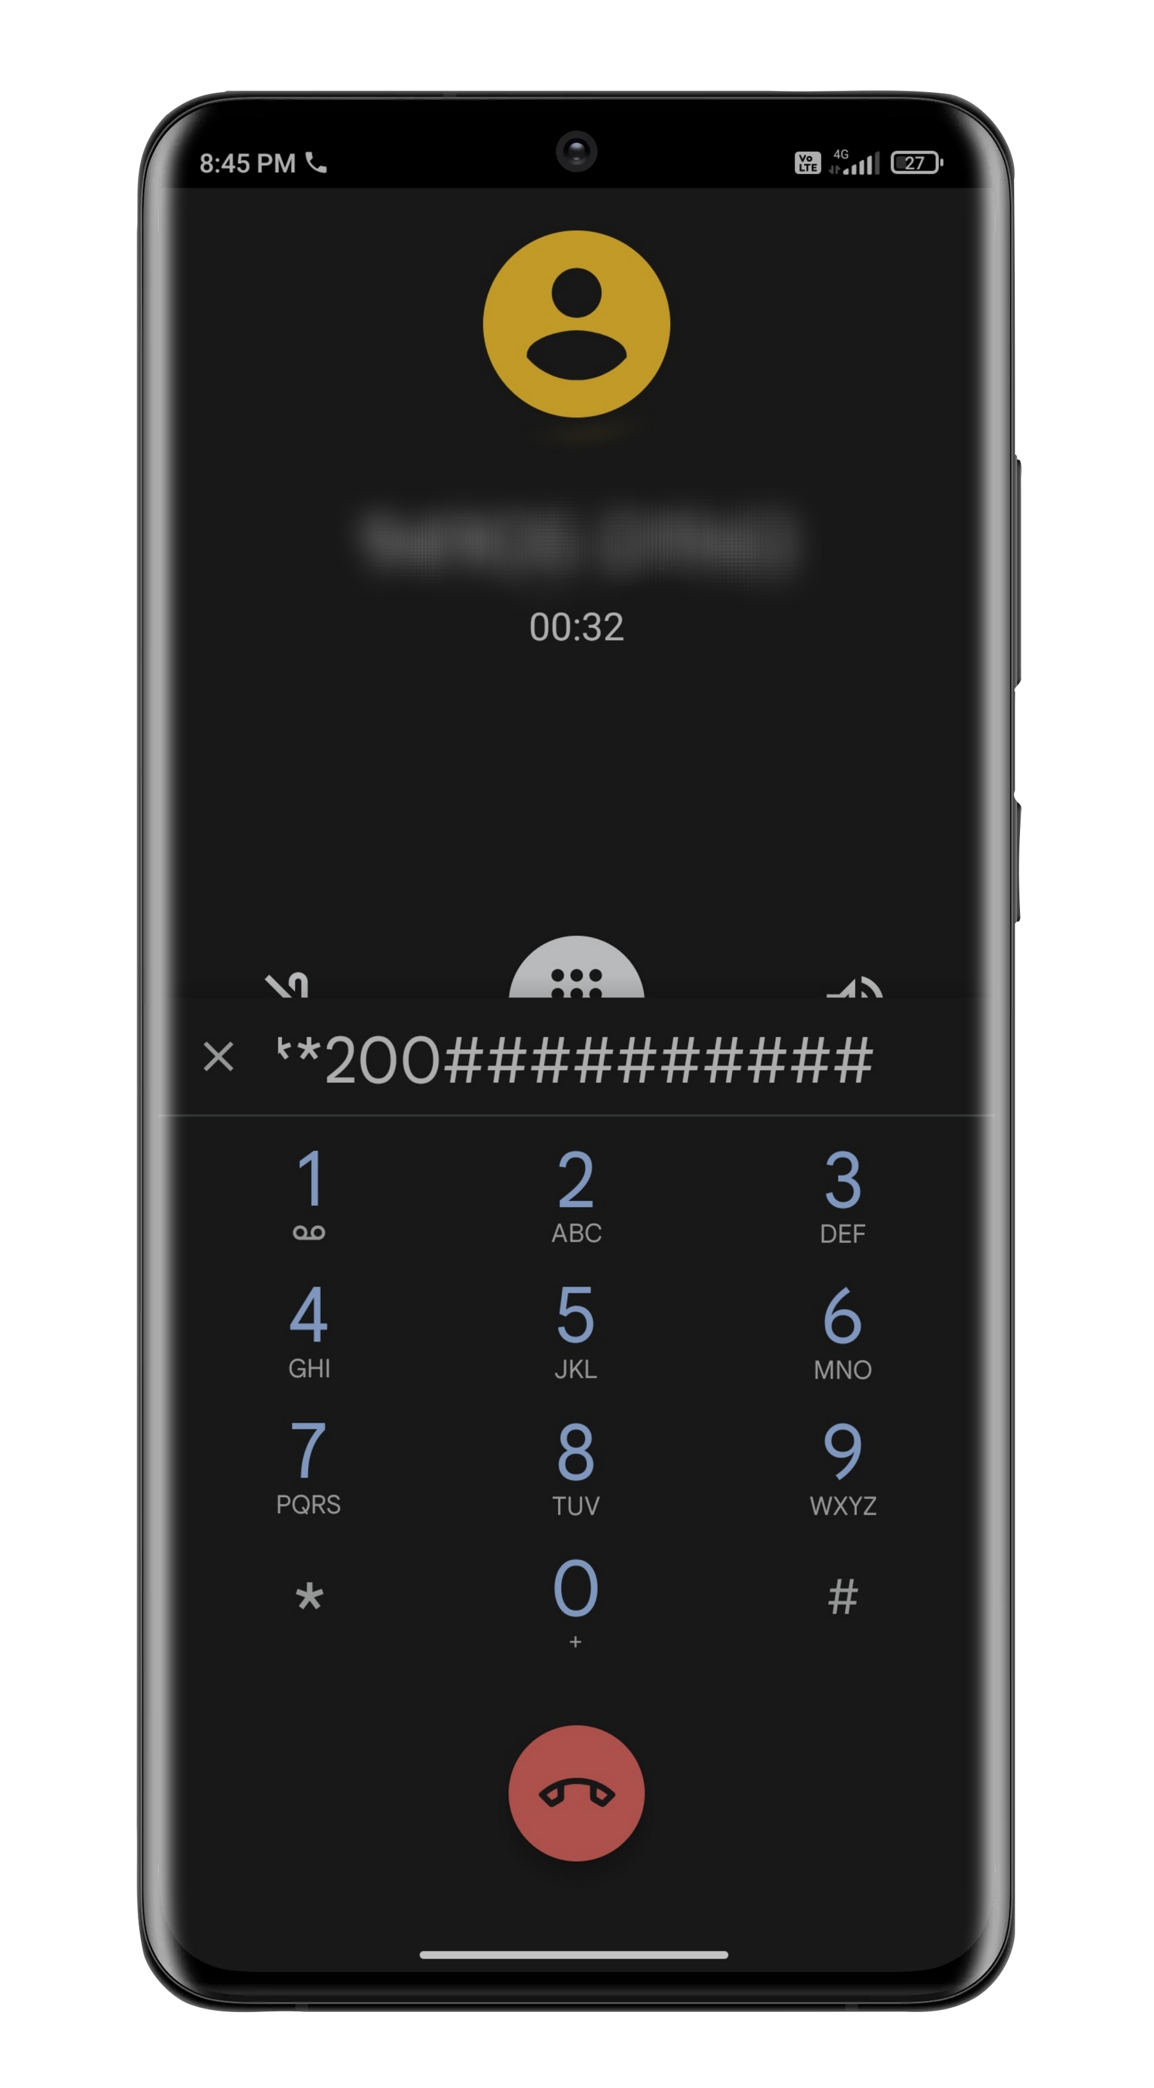
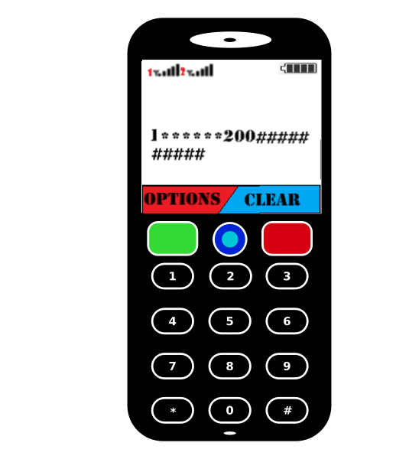
USAGE OF CPS
STEP 5:
NOW THE USER NEEDS TO ENTER THE PHONE NUMBER OF THE RECIPIENT IN THIS TRANSACTION. A FEATURE WHERE THE CALL BOT ANNOUNCES THE NAME OF THE RECIPIENT CAN BE ADDED

Slide 11
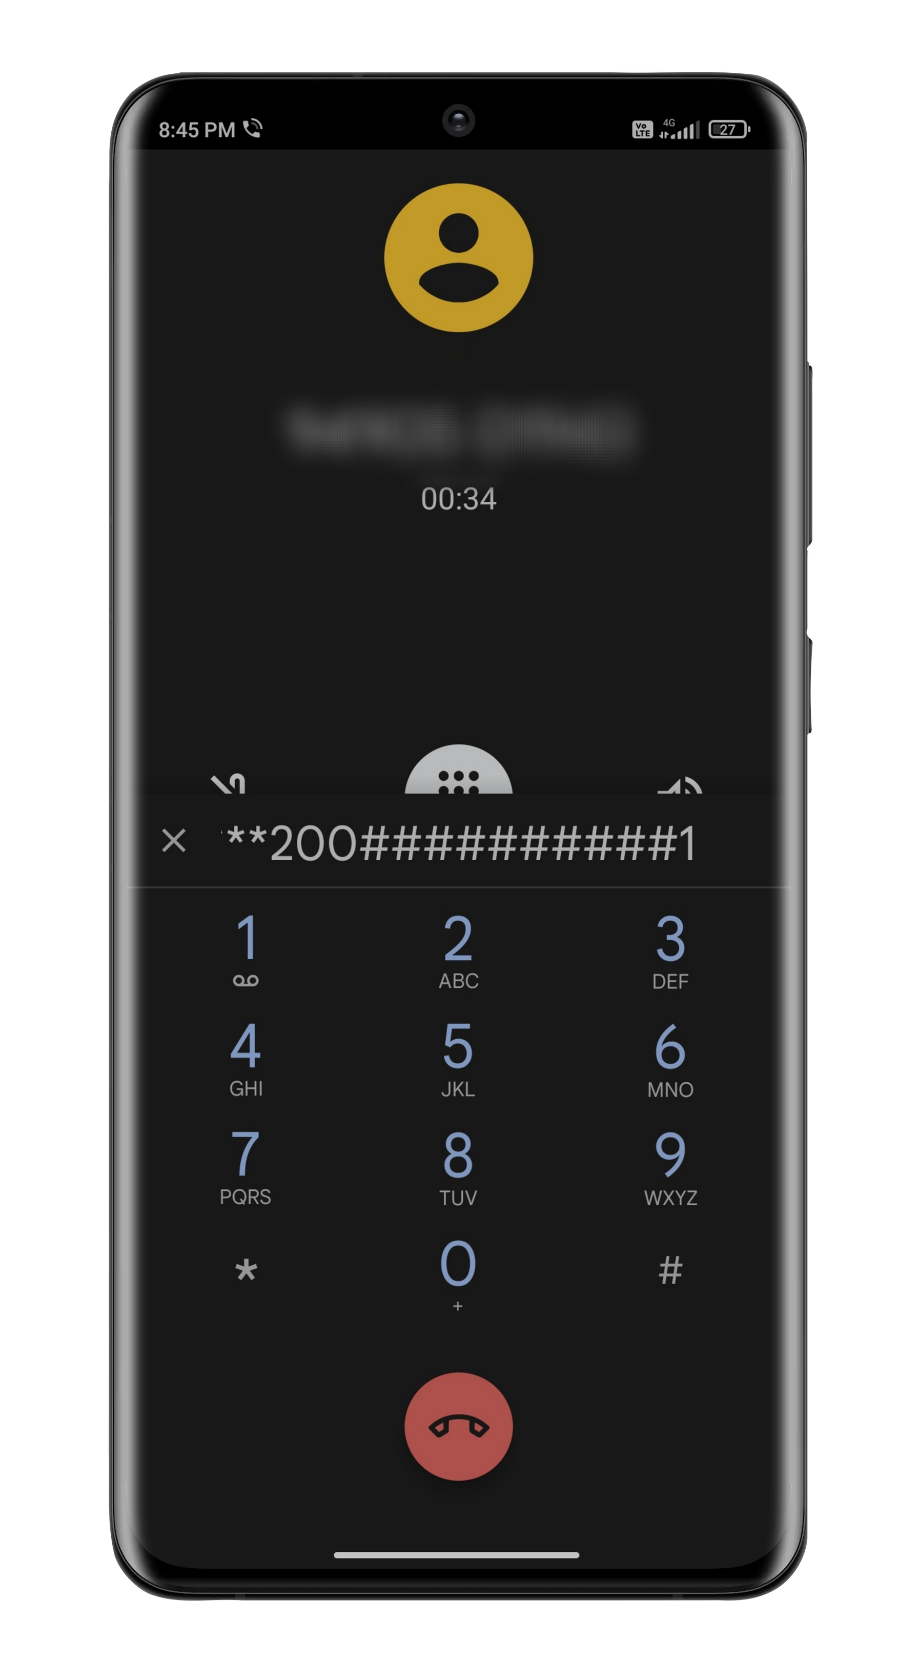
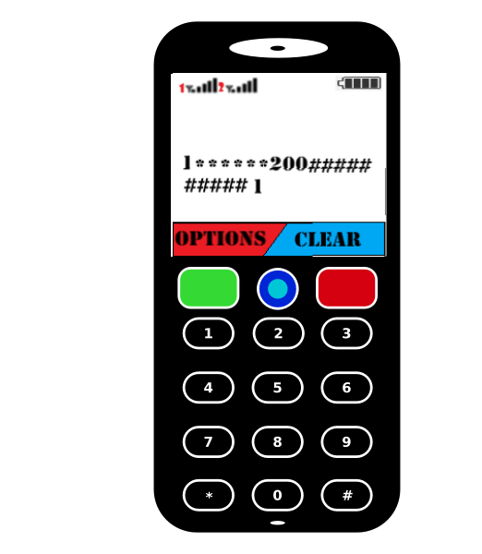
USAGE OF CPS
STEP 6:
NOW FINALLY, THE TRANSACTION SUMMARY WILL BE ANNOUNCED AND THE USER NEEDS TO GIVE THE FINAL CONFIRMATION (1 FOR YES AND 2 FOR NO) TO COMPLETE THE TRANSACTION

Slide 12
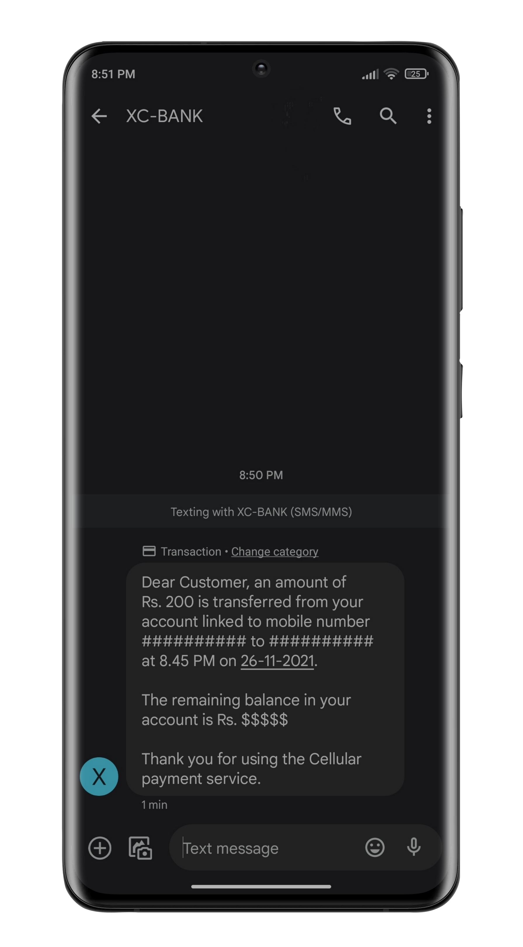
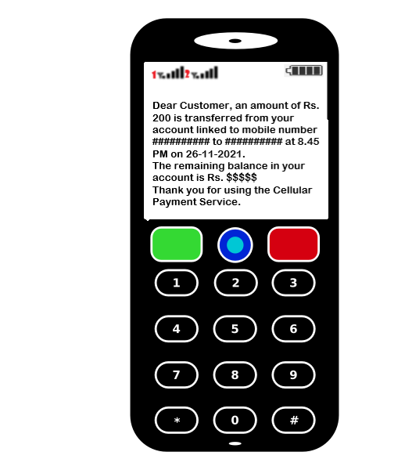
USAGE OF CPS
CONFIRMATION MESSAGE: AFTER THE TRANSACTION IS COMPLETED SUCCESSFULLY, THE USER WILL GET THE PRANSACTION SUMMARY AS AN SMS, WHICH ALSO INCLUDES HIS REMAINING BANK BALANCE

Slide 13

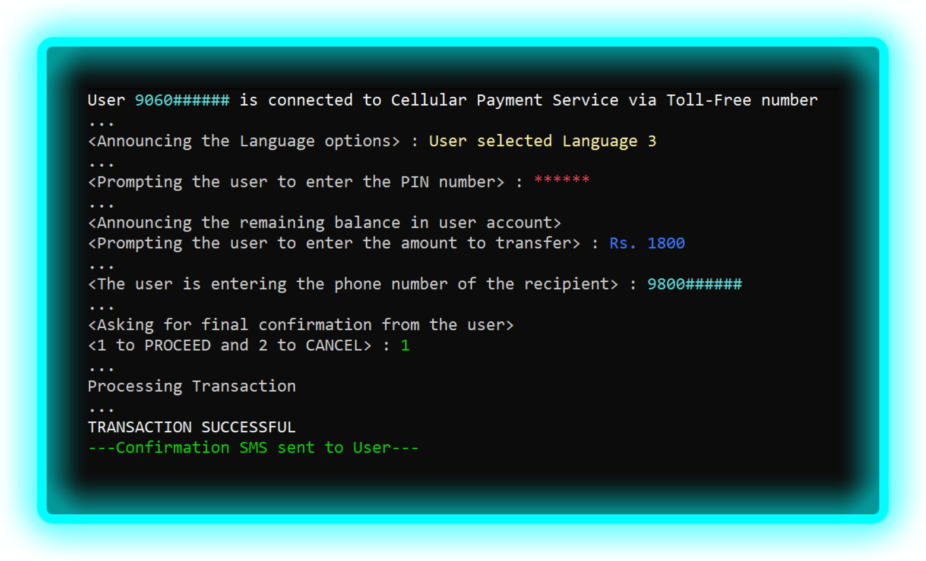
What happens in the backend?

Slide 14


EASIER WAY TO TRANSFER FUNDS
NO NEED OF ANY APP , WORKS ON ALL CELLULAR DEVICES
Benefits of of CPS
INSTANT TRANSFER OF FUNDS 24/7
QUICK PROCEDURE, WORKS WITHOUT INTERNET
DOES NOT REQUIRE ADDITIONAL SOFTWARE
ALL TRANSACTIONS ARE RECORDED
DRIVES INDIA TOWARDS DIGITAL PAYMENTS

Slide 15
Welfare schemes Regularization
1123.56M or 112.3 cr
PEOPLE GETTING BENIFITED WITH WELFARE SCHEMES
18,30,395 Crores
AMOUNT SPENT ON WELFARE SCHEMES IN INDIA PER YEAR

Slide 16


IT MEANS INDIAN GOVERNMENT IS SPENDING AROUND Rs. 16,300 PER YEAR ON EACH PERSON

Slide 17

Need for
Welfare Schemes Regularization
Part of money alloted for welfare schemes is being misused Economic survey of india 2016 stated that around 1 lakh crores is unevenly distributed to financially stable population in that year alone.
It is happening due to corruption and by producing fake documents .
Financially stable people are using fake certificates to get
subsidies and enjoying many benifits.

Slide 18


What is
Welfare schemes Regularization ?
Welfare scheme regularization is a process which verifies the user who is getting benefited with the subsidies. It involves checking weather he is financially stable or financially backward.
It does things like adding or removing the user from the central beneficiaries list

Slide 19
How Welfare schemes Regularization Works?
At the end of each year, all the users' total annual expenditure is calculated and users will be classified into different categories.
If the cummulative bank balance (or) expenditure
exceeds certain amount automatically removes his benificieries list.
then
/her
the software name from the

Slide 20



Benifits of
Welfare schemes Regularization
It is estimated that approximately 8 Crore people who are benifitting from faulty methods can be identified if India converts it's payments to Digital mode
About 1 Lakh Crore Rupees can be saved using this method and that money can be used for many purposes like development of nation, helping individuals in skill development.
It helps people to move away from poverty to productivity.

Slide 21

THANK YOU!
Have a great day ahead.

Slide 22


